Slide 1
Unit One Test Review
Language Arts 6
Bibliography

Slide 2
Plot Diagram | Picking the Plot | Crazy Conflicts | Setting the Setting | All Mixed Up!
200 | 200 | 200 | 200 | 200
400 | 400 | 400 | 400 | 400
600 | 600 | 600 | 600 | 600
800 | 800 | 800 | 800 | 800
1000 | 1000 | 1000 | 1000 | 1000

Slide 3
Plot Diagram 200
The organized pattern or sequence of events that make up a story.
Question

Slide 4
Plot Diagram
400
Here the characters are introduced and we also learn about the setting of the story. Most importantly, we are introduced to the main conflict.
Question

Slide 5
Plot Diagram
600
Here all loose ends of the plot are tied up. The conflict(s) and climax are taken care of.
Question

Slide 6
Plot Diagram
800
This part of the story begins to develop the conflict(s). A building of interest or suspense occurs.
Question

Slide 7
Plot Diagram
1000
This is the turning point of the story. Usually the main character comes face to face with a conflict.
Question

Slide 8
Picking the Plot
200
“In the end, they all lived happily ever after.”
This line is an example of the _____________ of a story.
Question

Slide 9
Picking the Plot
400
“Once upon a time, there lived a little prince on a far away planet. The little prince was lonely and searching for a friend.”
These lines are an example of the ___________ of a story.
Question

Slide 10
Picking the Plot
600
“This was it. The moment had finally come where Jason would face his nemesis, Tom Joker. One can’t live where the other survives. After this, nothing will be the same.”
These lines are an example of the _________ of a story.
Question

Slide 11
Picking the Plot
800
“Just then, Alexis heard a creek from behind her. She had the feeling as if someone had been following her the whole way home. She began to walk faster. It was probably her imagination. She walked this road home from almost every day. The idea of Halloween was probably messing with her mind. At that moment, she heard another set of footsteps directly behind her…”
These lines are an example of the ________ _________ in a story.
Question

Slide 12
Picking the Plot
1000
This is the French-term often used instead of resolution is known as _D__________.
Question

Slide 13
Crazy Conflicts
200
This type of conflict finds the main character in conflict with another character, human or not human.
Question

Slide 14
Crazy Conflicts
400
This type of conflict finds the main character in conflict with natural forces, which serve as the antagonist.
Question

Slide 15
Crazy Conflicts
600
This type of conflict has the main character in conflict with a larger group: a community, rules or traditions, culture, etc.
Question

Slide 16
Crazy Conflicts
800
Gavin’s quickly finished his language arts homework during class. Most of his friends had to take it home for homework. Now, they are asking him to share his answers. He worked hard on his worksheet and doesn’t think it is fair that they copy, however he doesn’t want to make his friends angry. He has a tough decision to make. This type of conflict is known as…
Question

Slide 17
Crazy Conflicts
1000
The middle school that Emma attends does not allow music played at the school dances. For years, the school has believed that music was a bad influence on children. Emma decided to gather signatures of parents and students who wished to have music played at school. She was going to present the signatures to the principal that evening. This type of conflict is known as…
Question

Slide 18
Setting the Setting
200
Setting can be described as the _______ and ________ of the story.
Question

Slide 19
Setting the Setting
400
If a story takes place hundreds of years ago, but the reader does not know the exact year, it is ok to say “the story takes place in the _______ _______.”
Question

Slide 20
Setting the Setting
600
“Jonathan sat nervously waiting for the interviewer to ask him the first question. This job would be perfect if he could just make it through the interview. He looked around the office and saw photos on the interviewers desk. He thought, “well, he looks like a normal guy in the photo. Maybe this won’t be so bad.” Jonathan could also see the daylight peeking through the window, He daydreamed for a moment what it would be like if he was outside instead of at this building. Just then he was startled out of his daydream by a buzzer… he forgot to turn his phone off!”
This story takes place in the _________ at a __________.
Question

Slide 21
Setting the Setting
800
“’Oh, no!’ thought BB-7, ‘I forgot to dismantle the protection protocol in the star unit.’ BB-7 was always finding ways to distract herself from the daily droid chores on the spacecraft. Everyday, BB-7 is responsible for dismantling the enemy shields so the spacecraft can be cleaned by a cleaning crew. BB-7 hoped to be promoted to main droid on board, however, it will never happen if her memory bank keeps malfunctioning!
This story takes place in the ________ ________ on a _______________.
Question

Slide 22
Setting the Setting
1000
Benjamin B. Buchanan entered the bank, ready to deposit his first check of honest, hard work. He had taken up a job down at Ol’ Hunter’s farm lot last week, and was just now getting his wages. He wore a suit coat and his nicest cap to deposit his money. The cashier said, “Here you go, sir? Would you like anything else?” Benjamin said, “Why, no ma’am. I think I am just dandy.” He tipped his hat at her, and walked away smiling.
This story takes place in the ________ at a ________.
Question

Slide 23
All Mixed Up! 200
If a story takes place many years from now, but the reader does not know the exact year, it is ok to say “the story takes place in the _______ _______.”
Question

Slide 24
All Mixed Up! 400
The University of Michigan versus Michigan State football game is an example of this type of conflict.
Question

Slide 25
All Mixed Up! 600
Now, that the big fight is over. Mary and Sally decided to walk home as friends. On the way, they recapped their feud that they had been in. Now that they were friends again, The girls talked about their future plans, and even made a date for a sleepover together. Both Mary and Sally were excited to finally have their best friend back. “They talked about future plans, and even made a date for a sleepover” is an example of…
Question

Slide 26
All Mixed Up! 800
A type of conflict that occurs inside the body or mind of a character.
Question

Slide 27
All Mixed Up! 1000
If the ____________isn’t clearly stated, look for clues as to where and when the story is happening.
Question

Slide 28
Plot Diagram 200
What is Plot?
Game Board

Slide 29
Plot Diagram 400
What is the exposition.
Game Board

Slide 30
Plot Diagram 600
What is the falling action?
Game Board

Slide 31
Plot Diagram 800
What is the rising action?
Game Board

Slide 32
Plot Diagram 1000
What is the climax?
Game Board

Slide 33
Picking the Plot
200
What is the resolution?
Game Board

Slide 34
Picking the Plot
400
What is the exposition?
Game Board

Slide 35
Picking the Plot
600
What is the climax?
Game Board

Slide 36
Picking the Plot
800
What is rising action?
Game Board

Slide 37
Picking the Plot
1000
What is Denoument?
Game Board

Slide 38
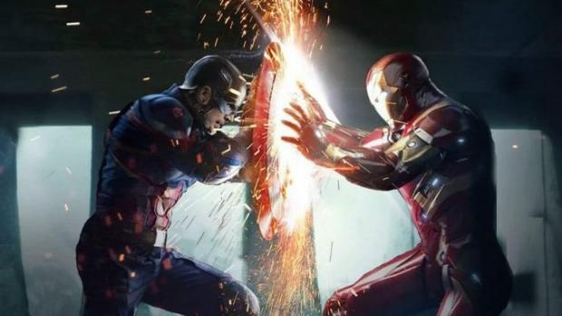
Crazy Conflicts!
200
What is Character vs. Character?
Game Board

Slide 39
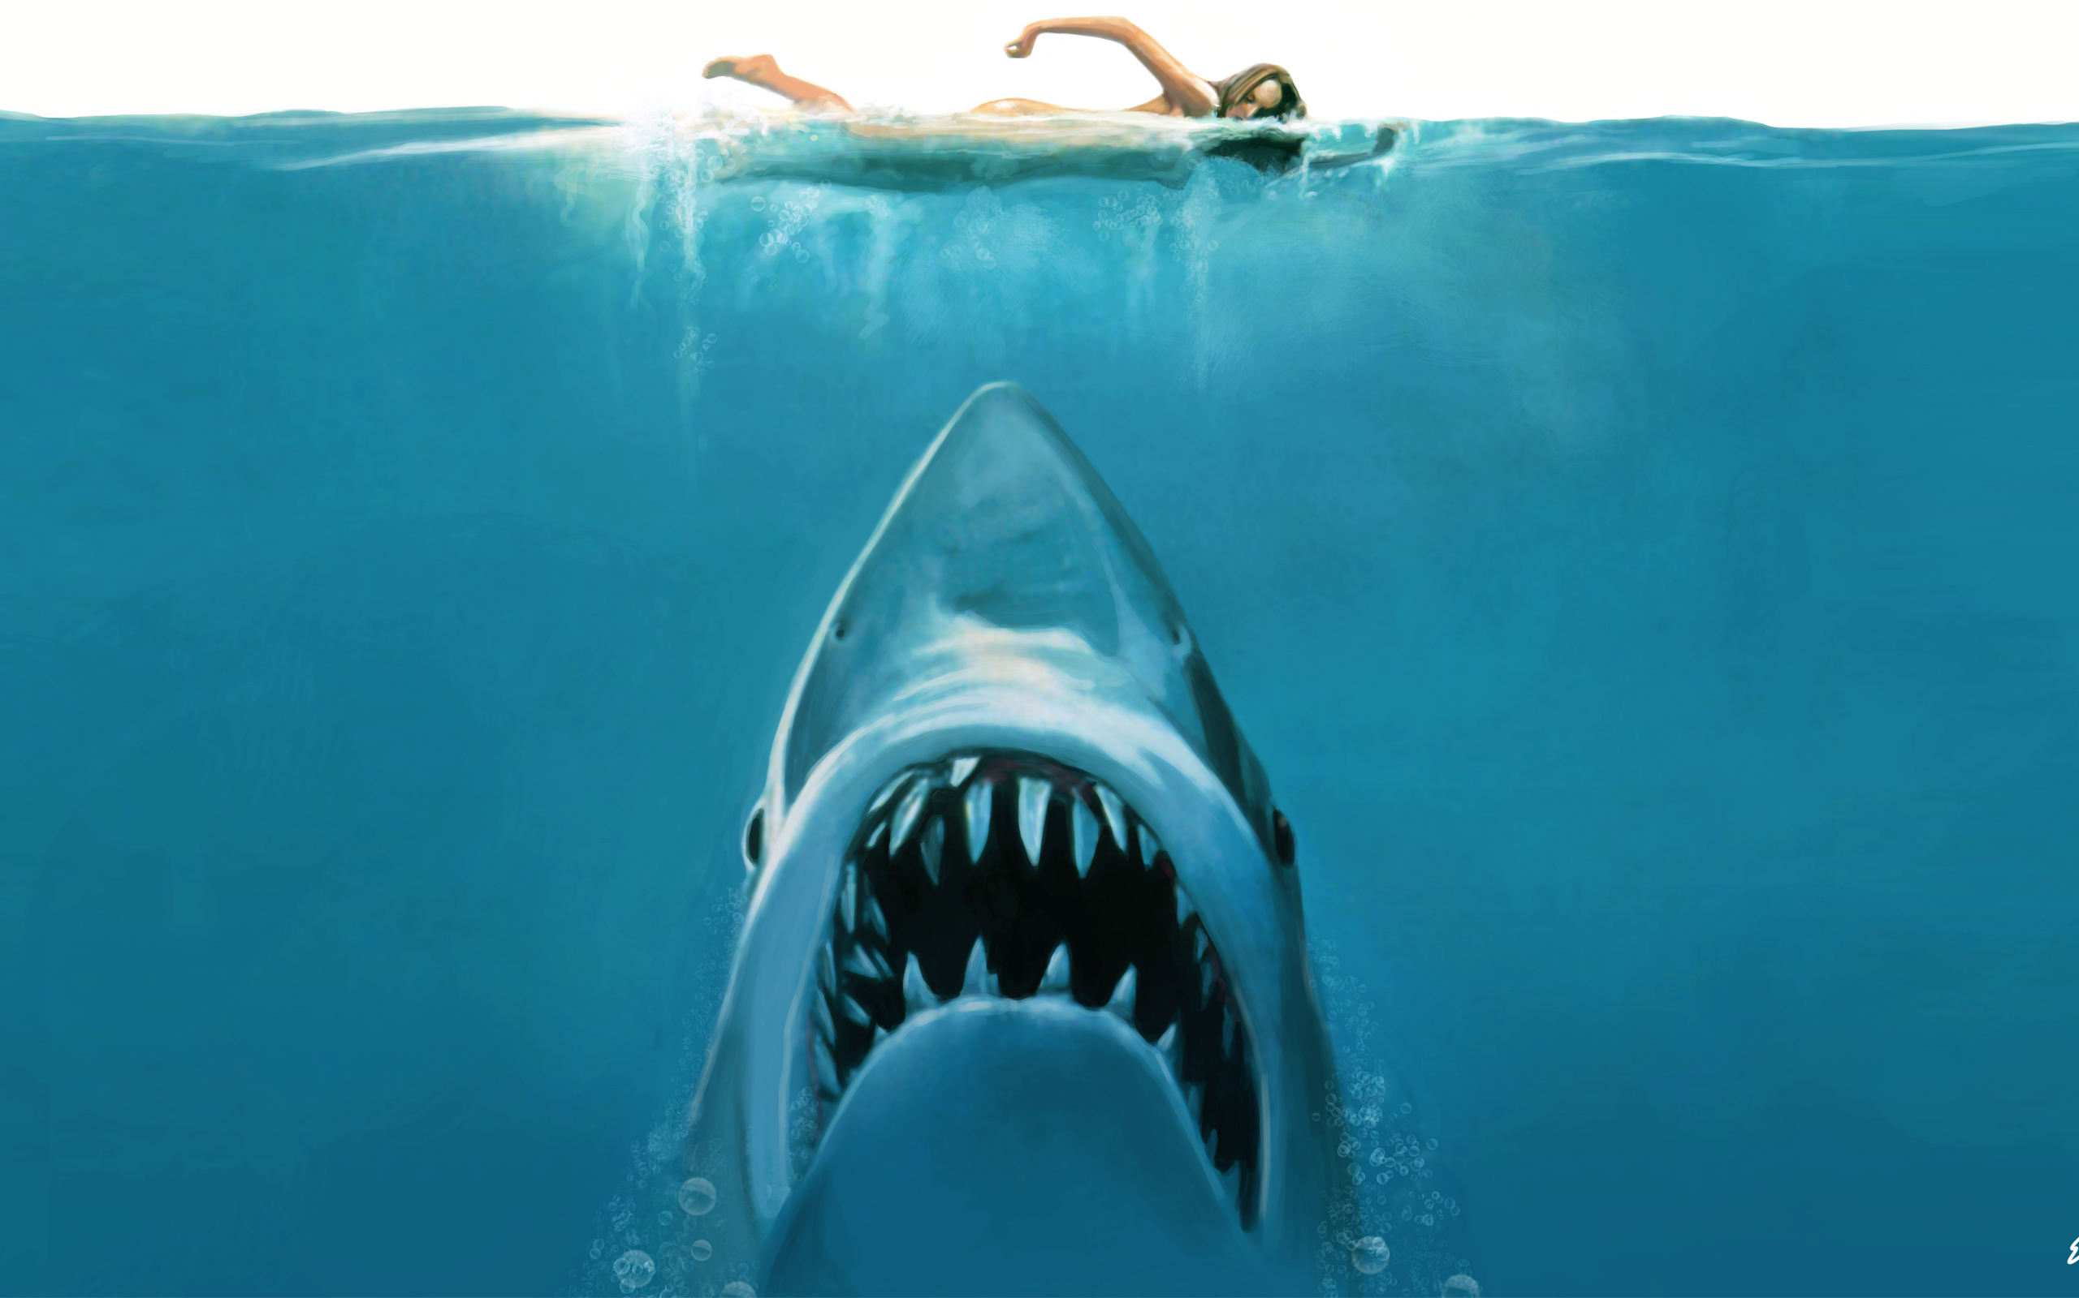
Crazy Conflicts
400
What is Character vs. Nature?
What is Character vs. Nature?
Game Board

Slide 40
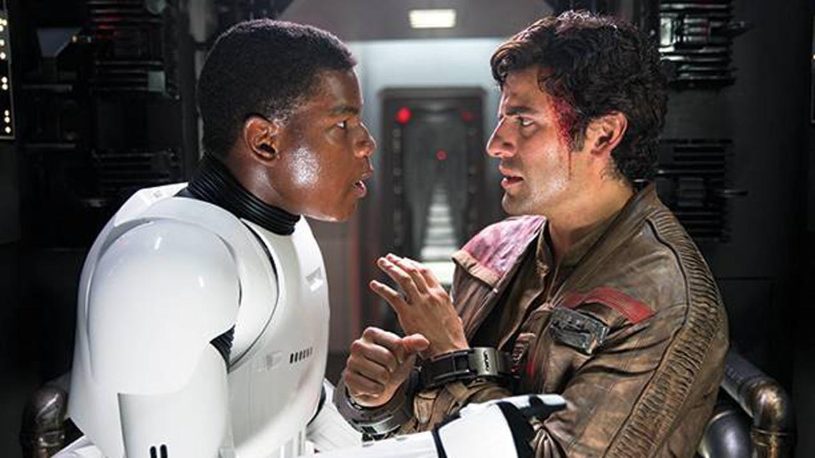
Crazy Conflicts
600
What is Character vs. Society?
Game Board

Slide 41
Crazy Conflicts
800
What is Character vs. Self?
Game Board

Slide 42
Crazy Conflicts
1000
What is Character vs. Society?
Game Board

Slide 43
Setting the Setting
200
What is time and place?
Game Board

Slide 44
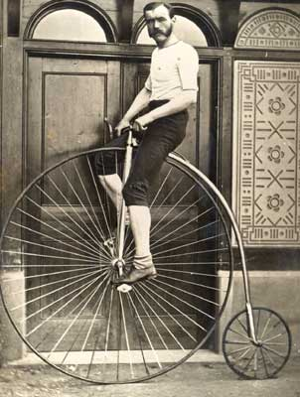
Setting the Setting
400
What is the distant past?
Game Board

Slide 45
Setting the Setting
600
What is the present and an office building?
Game Board

Slide 46
Setting the Setting
800
What is the distant future and on a spacecraft?
Game Board

Slide 47
Setting the Setting
1000
What is the past and at a bank?
Game Board

Slide 48
All Mixed Up! 200
What is the distant future?
Game Board

Slide 49
All Mixed Up! 400
What is Character vs. Character?
Game Board

Slide 50
All Mixed Up! 600
What is falling action?
Game Board

Slide 51
All Mixed Up! 800
What is internal conflict?
Game Board

Slide 52
All Mixed Up! 1000
What is setting?
Game Board

Slide 53
Bibliography
N/A. "The Great Gatsby." Wikipedia. Wikimedia The Free Encyclopedia, 12 Sept. 2013. Web. 15 Sept. 2013.
Cumaraswamy Streat, Shanthi. "Happy Birthday, William Shakespeare!" Web log post. The World Is Your Oyster. 23 Apr. 2013. Web. 14 Sept. 2013.
Merriam-Webster.com. Merriam-Webster, 2011.Web. 16 Sept. 2013.
Game Board

